Slide 1
Delivery of mitoceuticals or respiratory competent mitochondria to sites of neurotrauma
Samir P. Patel

Slide 2

Mitochondria are important in the injured brain and spinal cord, and can be delivered to the injured CNS to improve recovery.

Slide 3
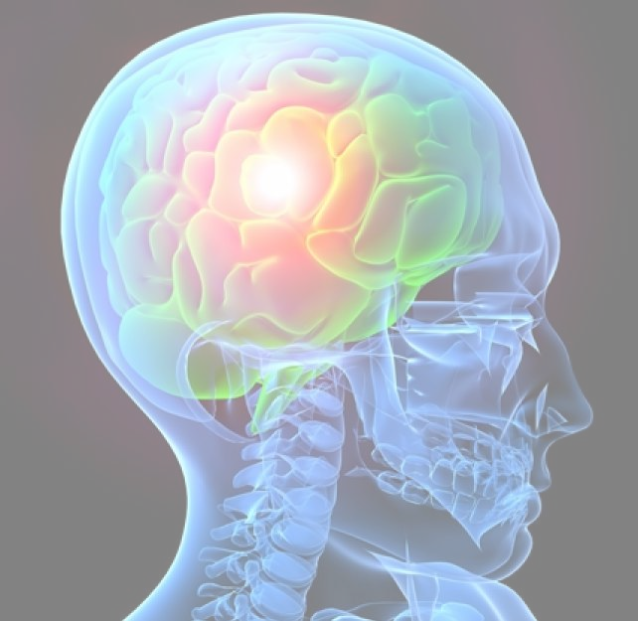
pioglitazone is neuroprotective in SCI, but not TBI.

Slide 4

Mitochondria are a promising therapeutic for spinal cord injury, but there are still many questions to be answered.

Slide 5
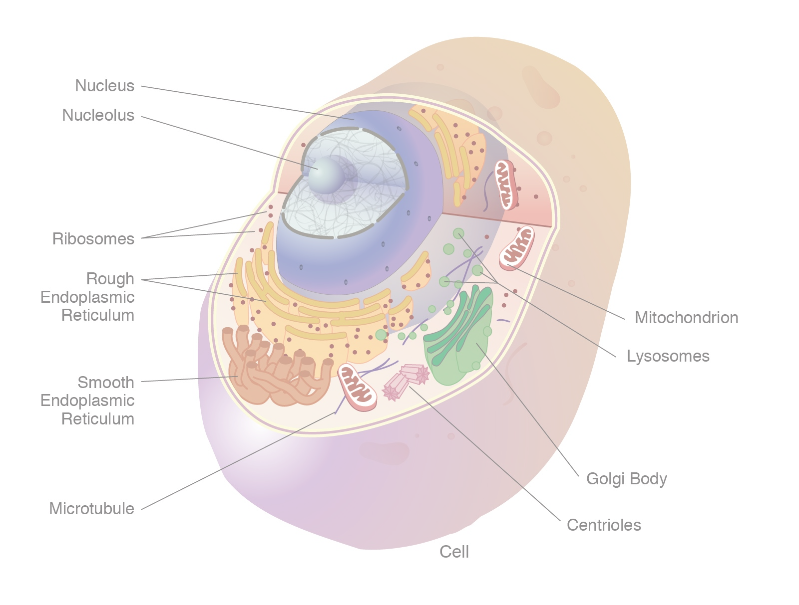
mitochondria are the powerhouses of the cell, and they are the most abundant organelle in the cell. They are responsible for generating ATP, which is the primary source of energy for the cell. Mitochondria are also the main source of ROS, which are damaging to the cell. Mitochondria are present in almost all eukaryotic cells, and they are essential for life. Mitochondria are inherited from the mother, and they are passed down to the next generation. They are also the main source of mtDNA, which is inherited from the mother. Mitochondria are also the main source of mtDNA, which is inherited from the mother.

Slide 6

Mitochondria are the power plants of the cell, and are critical for life. They are the

Slide 7
Mitochondria are the power plants of the cell. They generate ATP, which is the energy currency of the cell. Mitochondria are also involved in the production of reactive oxygen species (ROS) and other reactive molecules, which are toxic if not properly regulated. Mitochondrial dysfunction is implicated in a wide range of diseases, including neurodegenerative diseases and cancer.

Slide 8
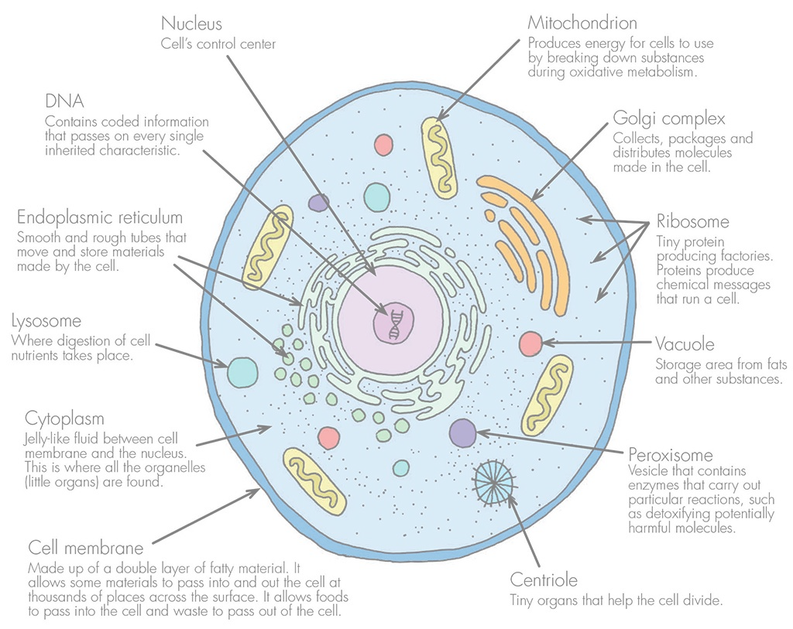
Mitochondria are the powerhouses of the cell, and they are the most abundant source of free radicals in the cell. In the case of a spinal cord injury, the mitochondria are damaged, and the free radicals produced by the mitochondria are responsible for the secondary damage that occurs to the surrounding cells. In this paper, the authors show that injecting mitochondria into the spinal cord can reduce the secondary damage. This is a very cool paper, and I would like to see it move forward. I think the authors need to go back and revise the Introduction and Discussion to make it clear that they are not claiming that this is a cure, but rather that this is a promising therapy that needs to

Slide 9
Mitochondria are the power plants of the cell. They are the place where the majority of cellular energy is generated. Mitochondria are also the place where the majority of cellular oxygen is consumed. Mitochondria are the place where the majority of cellular calcium is stored. Mitochondria are the place where the majority of cellular iron is stored. Mitochondria are the place where the majority of cellular nitric oxide is generated. Mitochondria are the place where the majority of cellular hydrogen peroxide is generated. Mitochondria are the place where the majority of cellular free radicals are generated. Mitochondria are the place where the majority of cellular ATP is generated. Mitochondria are the

